Slide 1




Trading social status for genetics in marriage markets: Evidence from UK Biobank
Abdel Abdellaoui, Oana Borcan and David Hugh-Jones
UEA internal seminar February 2021

Slide 2
Basic thesis of modern behavioural genetics:
Genetic data explains social outcomes.
What’s a social scientist to do?
One answer: find out where the genes come from.
Genetic assortative mating (Hugh-Jones et al. 2016).
Geographic sorting (Abdellaoui et al. 2019).
Natural selection (Hugh-Jones and Abdellaoui 2021, working paper).
This paper.

Slide 3
Inequality persists over generations. It can be surprisingly persistent over time (Clark and Simmons 2015; Solon 2018).
Families are part of the mechanism, since wealth, human capital and other traits are passed from parents to children.
Assortative mating (where like marries like) can increase inequality (Fernandez and Rogerson 200; Fernandez et al. 2005; Schwartz and Mare 2005; Greenwood et al. 2014; Eika et al. 2019).

Slide 4
Human genetics are also inherited, and help to explain inequality:
Heritability of occupational class and educational attainment is about 50% (Tambs et al. 1989).
2-year-old children’s family socio-economic status can be predicted from their genes (Trzaskowski et al. 2014).
Polygenic scores for educational attainment predict occupational class (Rimfeld et al. 2018).
The leading explanation for this gene-status gradient is meritocracy. “Good genes” lead to upward mobility.

Slide 5
We offer a new explanation for the genes-status gradient, based on assortative mating.
Social status and “good” genes both contribute to attractiveness in marriage markets.
Both are inherited.
As a result, both become associated in the next generation.
Shocks to social status are reflected in children’s genetics.
Genes-status gradient is likely historically widespread.
We test this theory using data from the UK Biobank.

Slide 6
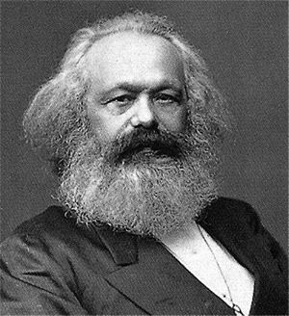
“I am ugly, but I can buy the most beautiful woman.... the effect of ugliness, its repelling power, is destroyed by money.” – Karl Marx

Slide 7

“Part of the beauty of me is that I am very rich.” – Donald Trump

Slide 8
Theory
Individuals in a large population have a genetic trait g and a social status s drawn from distributions G, S.
They match according to an attractiveness function
A(g, s) = f((1-k)g, ks)
f is strictly increasing in its arguments.
k describes the society’s marriage market. If k = 0, only genetics matter. If k = 1, only social status matters. For realistic societies, 0 < k < 1.
Technical condition: distribution of (G, S)|A = a is non-degenerate, and has positive measure, for at least some a.

Slide 9
People match with others of equal attractiveness and have children who inherit g and s:
g_{c} = (g_{d} + g_{m} )/2
s_{c} = (s_{d} + s_{m} )/2
Write G_{p}, S_{p} and G_{c}, S_{c} for the distribution in the parents and children’s generation respectively.
Proposition
i) Cov(G_{c}, S_{c}) ≥ Cov(G_{p}, S_{p}) with strict inequality if and only if 0 < k < 1.
ii) If corr(G_{p}, S_{p}) ≥ 0, then corr(G_{c}, S_{c}) ≥ corr(G_{p}, S_{p}), with strict inequality if and only if either 0 < k < 1 or corr(G_{p}, S_{p}) > 0.

Slide 10
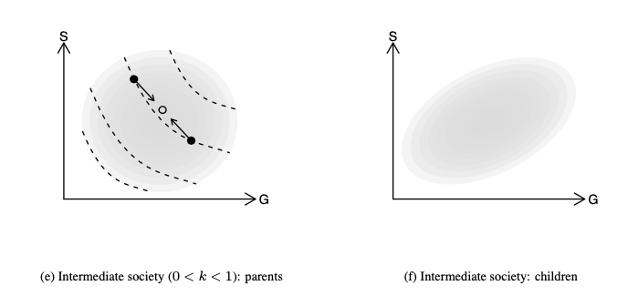

Slide 11
Data
UK Biobank, a study of about 500,000 individuals born 1935-1970. Contains questionnaire data on health and social characteristics, also DNA data. Non-representative!
We don’t have explicit information on spouse pairs.
We categorize people as pairs if they:
• had the same home postcode
• have the same homeownership/renting status, length of time at the address, and number of children
• attended the same UK Biobank assessment centre on the same day;
• both reported living with their spouse (“husband, wife or partner”);
• consisted of one male and one female.

Slide 12
Validating our pairs
Some respondents in the sample have a child who is also in the sample (inferred from genetics).
Among our spouse pairs, 511 have a genetic child of at least one partner in the sample. Of these, 441 (86%) are children of both partners.
Comparison: 11% of families with dependent children included a stepchild (Census 2011).
We re-estimate our models using a set of “known fake pairs”. Coefficients are closer to zero than among our pairs.
→ Remaining fakes in our data are likely to bias our coefficients to zero.

Slide 13
Dependent variable: Polygenic Score for Educational Attainment (PSEA). DNA-derived summary statistic which predicts people’s level of educational attainment.
University attendance by PSEA decile

Slide 14
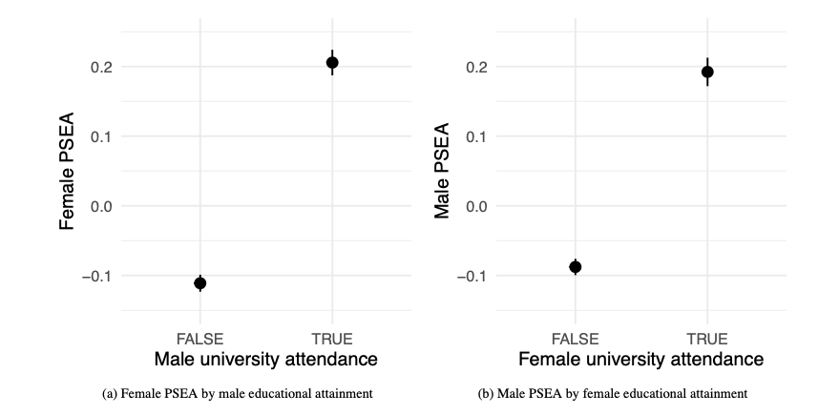

Slide 15
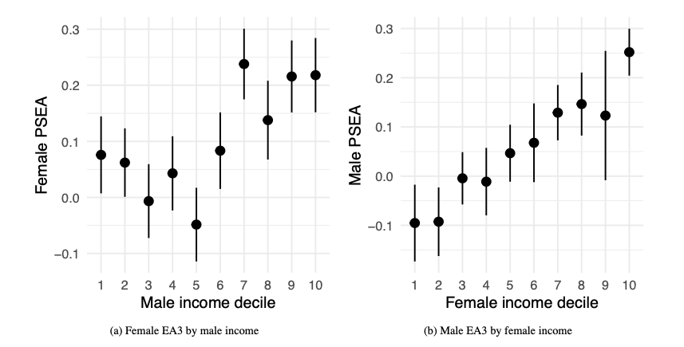

Slide 16
We already know that there is assortative mating on PSEA (Hugh-Jones et al. 2016).
To avoid this confound, we need an independent variable which is
independent of genetics;
available for a large enough N.
We use birth order.
Siblings have the same expected polygenic scores, by the “lottery of meiosis”.
Early-born siblings receive more parental care, have better life outcomes including educational attainment, SES (Lindahl 2008; Booth and Kee 2009; Black, Devereux, and Salvanes 2011).

Slide 17
Estimation strategy
Hard to justify instrumental variables:
Birth order affects other things than SES.
We only have imperfect measures of SES (rough household income, job, educational attainment).
Instead we run a mediation analysis:
Does birth order affect spouse’s PSEA?
Is the effect mediated by measures of SES?

Slide 18
Controls and mediators
Mediators
University attendance
Median earnings of first job (estimate from 2000 SOC code)
Controls
Family size
Month of birth
Year of birth
Parent’s age at birth (correlates with birth order! Only available for some respondents)

Slide 19
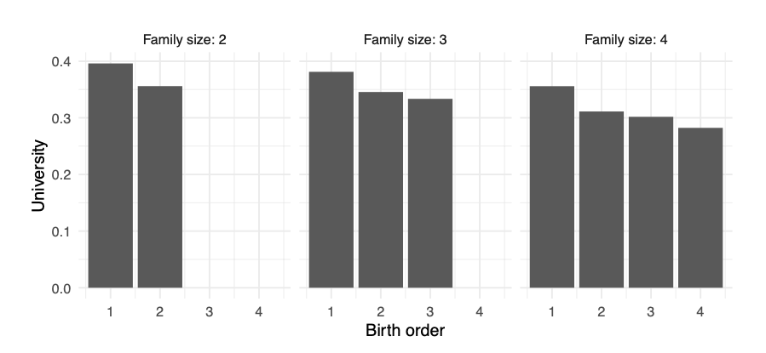

Slide 20
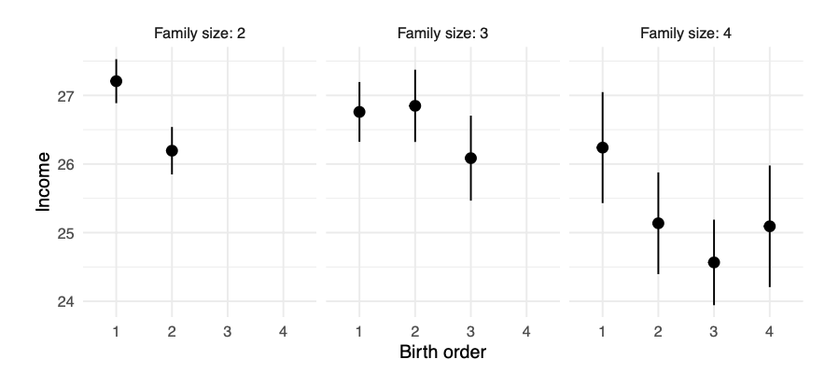

Slide 21
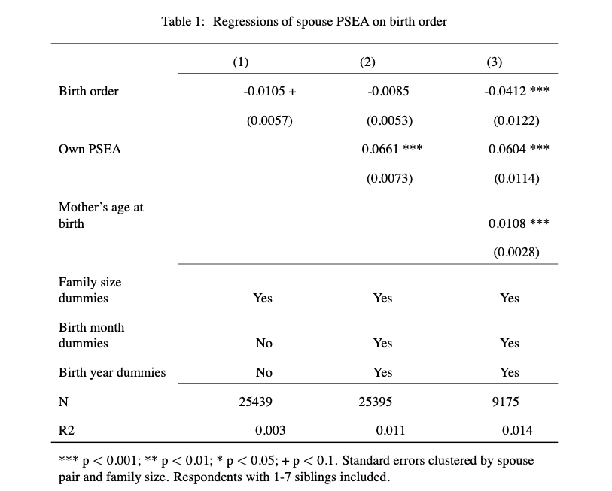

Slide 22
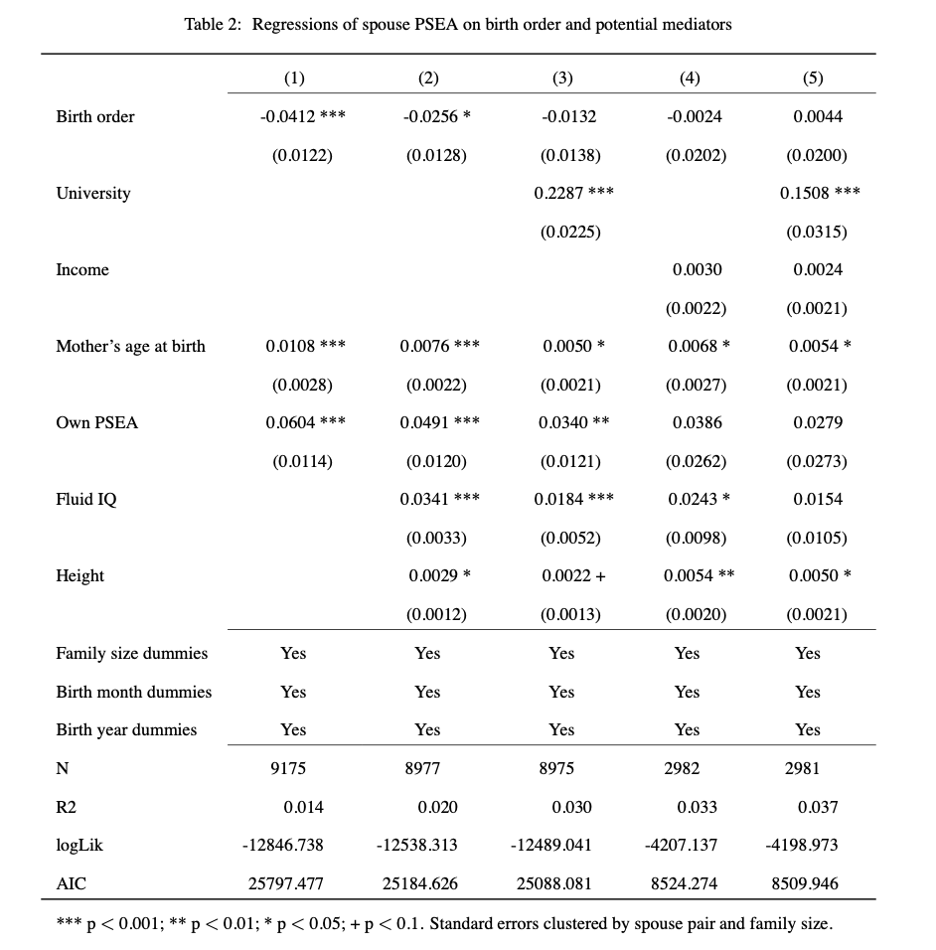
Mediators
Controls

Slide 23
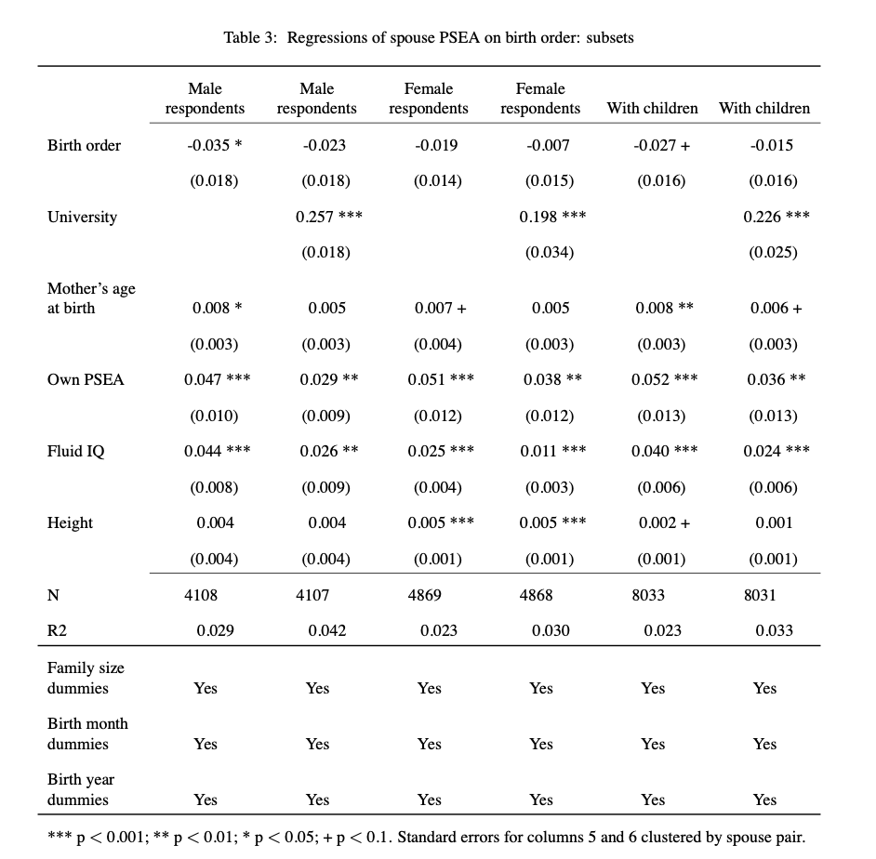

Slide 24
Assortative mating in marriage markets can explain the genes-status gradient.
This explanation applies to a wider range of societies than the key rival.
Prediction: genes-status gradient should be visible in ancient DNA.
Shocks to socio-economic status are reflected in the DNA of descendants.
Part of how elite families maintain their position over time (Clark 2015)?

Slide 25
Popular discourse and the media (and scientists!) often oppose “nature” to “nurture”.
The idea is that DNA is fixed at conception, and affects individual outcomes thereafter.
However, across generations, DNA is a social outcome.

Slide 26
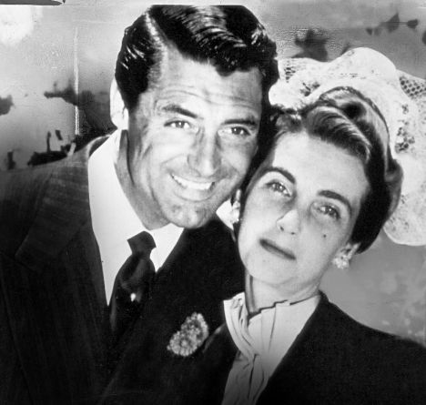

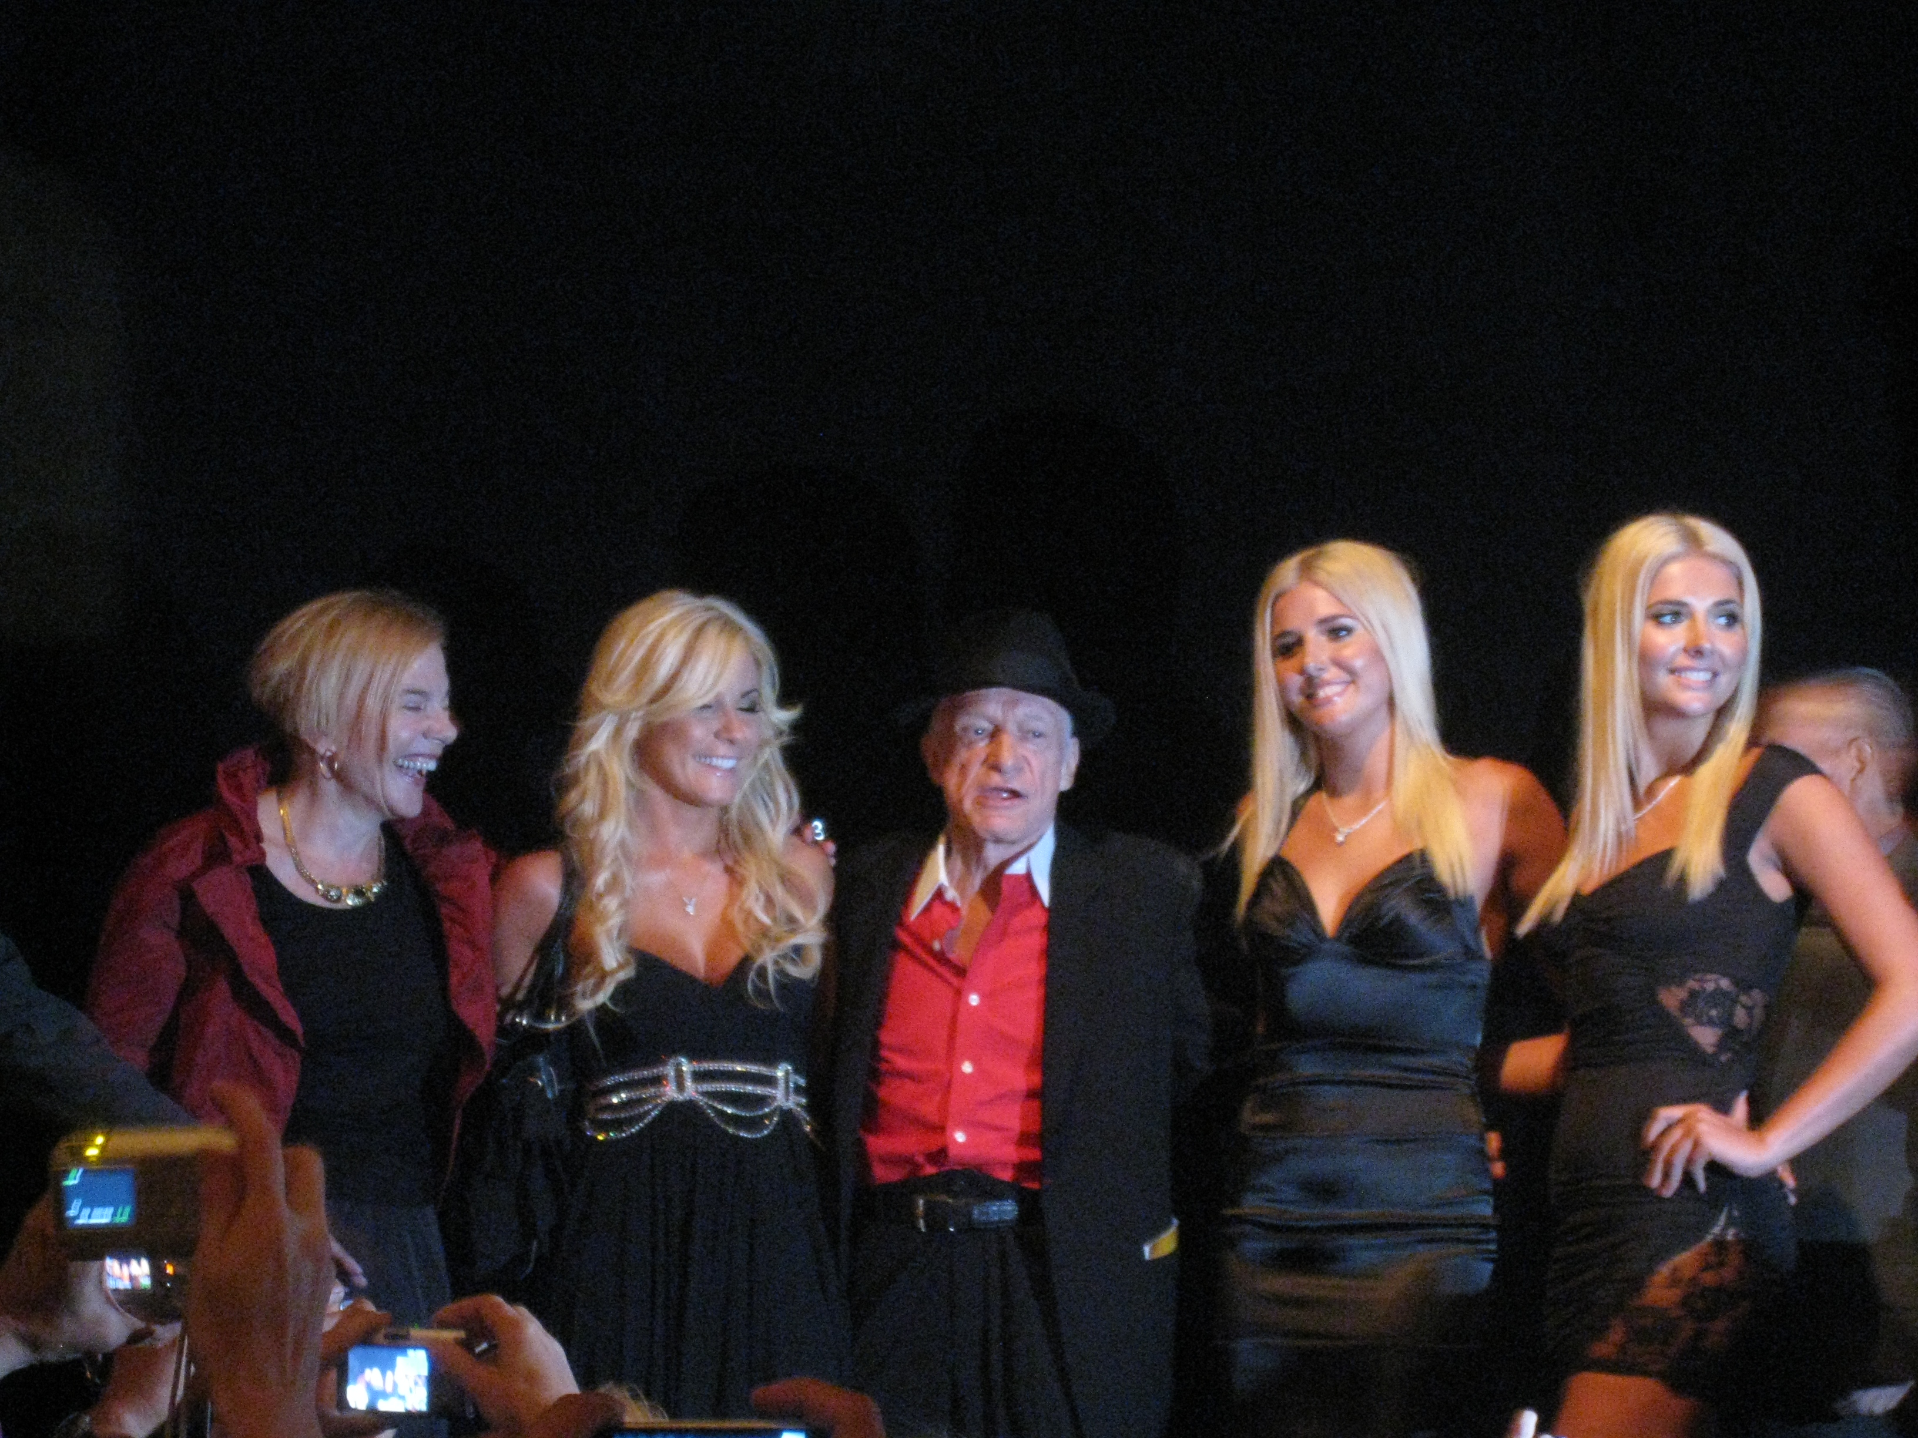
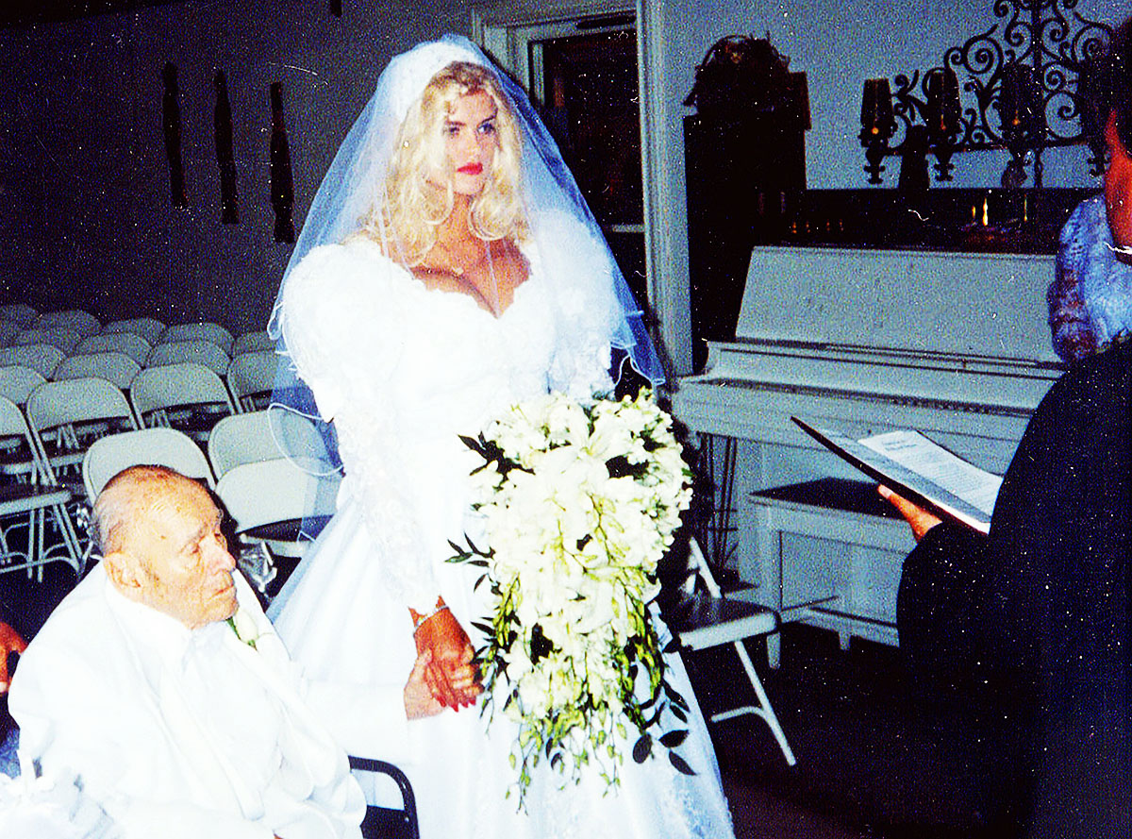
Thanks!

